Slide 1



Good Morning Everyone
From Mrs Brookes

Slide 2
Home learning – I hope it is going well!
A huge thank you to parents who are embarking on Home learning form this week. Your child’s teacher will be updating the class pages regularly and this should be your first port of call.
Remember – you cannot replicate an entire school day but it is good to have a bit of structure each day.
Don’t expect to do too much in 1 day – You can only concentrate for short periods of time so it is better to do that than sit for hours.
Think about what you want to achieve by the end of the week and work from that.

Slide 3
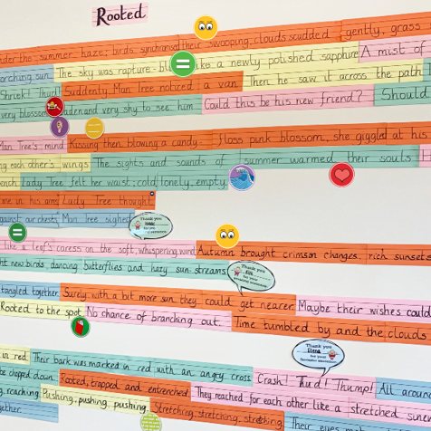
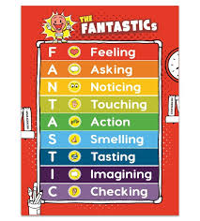




Don’t forget to mix up writing tasks with online learning.

Slide 4
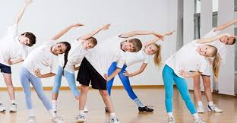
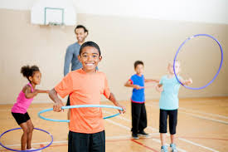
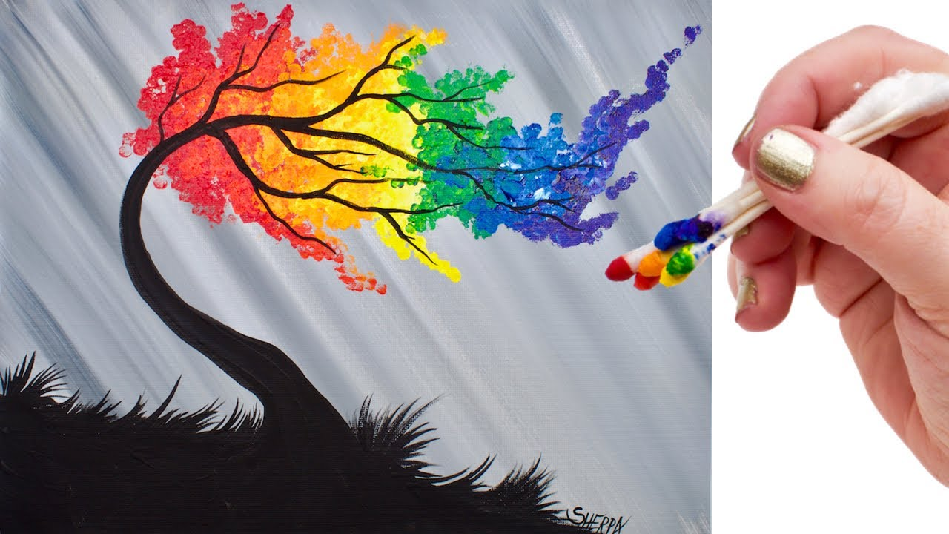
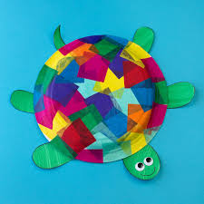
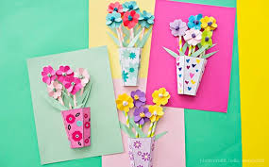
Get exercise when you can and think of creative ways to spend your time.

Slide 5





We would love to know if you have found a good book that you would like to share with your friends.

Slide 6

Paint a Rainbow
To show that we are all still keeping in touch, paint or colour a Rainbow and put it up in your front window and write the message
STAY SAFE
If you drive past school, you will see we have done one too!

Slide 7

Don’t forget to follow us on Twitter!
@teresacatholic

