Slide 1

Key Stage One Expectations

Slide 2
Meet the Teacher!
Class teacher
Mrs Thompson
Teaching Assistant
Mrs McKeon
Mrs Carpenter

Slide 3
Welcome
Throughout the year, information will be sent home via:
The school website - St Teresa's Catholic Primary Schoo - Home
Weekly newsletter
Teachers2Parents
Text
The Year 1 and 2 class page – St Teresa's Catholic Primary Schoo - Year 1 and 2
School Facebook page
Please check your emails, texts, the school website and facebook regularly for any new information

Slide 4
The St Teresa’s Way
#TeamTeresa

Slide 5
Mission Statement
A welcoming family of God, growing and achieving together with Jesus at our side.
“I am the vine, you are the branches”.

Slide 6
Code of Conduct
As part of God’s family:
We celebrate differences and diversity
We all matter
We respect each other by listening
We all have a voice
We protect each other and our school
We feel safe
We encourage each other to be the best we can be
We enjoy how we learn from each other

Slide 7
What is different this year?
Our new Behaviour Culture.
Track It Lights behaviour tracking and rewards
Different playground zones so there is something for all at break times.
Staggered breaks and lunches to ensure safe breaktimes for everyone.
Young Carers champions

Slide 8
Catholic Life
Daily Prayer
Daily Collective Worship
New R.E.D (Religious Education syllabus)
Hymn Practice
Weekly Mass
Celebration Mass
SVP – Mini Vinnies
Chapel – private reflection time

Slide 9
Positive Mental Health and Wellbeing
As always, your child’s mental health and wellbeing is paramount to all staff at St Teresa’s. All children have access to:
Weekly RSHE lessons including Pol-Ed resources and online safety.
Our school’s Learning Mentor – Mrs Hayes
Caring staff who listen and respond
Our school Chapel where they can go for quiet reflection

Slide 10
Key Stage One expectations
National Curriculum 2014 – please see the link on the Year 1 and 2 class page.
Handwriting – The children will be taught how to write cursively following RWI handwriting.

Slide 11
Homework
We expect children to read a minimum of five nights a week. Books will be sent home weekly and will be in line with your child’s reading ability.
One Minute Maths – You can download the app for free on most tablets.

Slide 12
Rewards
Everyone at St Teresa’s believes in praising positive behaviour and hard work!
Weekly Celebration certificates– Gospel Values, school Expectations and personal best for each class.
Bronze, silver, gold and platinum Track It Lights certificates.
Green role model badge ( 2026-7)
Phone calls home and praise cards

Slide 13
Rewards and Sanctions
When dealing with any child who displays negative behaviours, or any child who receives negative behaviour from another child, we strongly believe that all of our children have the right to be heard and that they feel like they have been listened to - Reflection
All staff ensure that any situations are followed up promptly and that the child/children involved feel like the situation has been dealt with in a manner that they are happy with/understand.
In line with our new Track It Lights system, staff will be recording daily behaviours and children will have the opportunity to achieve three green points each day which will link in with the certificates.
All behaviour will be dealt with in our therapeutic and restorative approach – more information available on the website.

Slide 14
Dealing effectively with parental concerns
We aim to maintain the high standard of communication between home and school that you expect from us. Please use our school email or phone the Office if you have any queries and the relevant member of staff will get back to you as soon as possible. If you have a concern about your child, please contact the named person in the order below.
1st point of contact - Class teacher
2nd point of contact – Behaviour Lead – Mrs Halliwell
3rd point of contact – Acting Deputy Headteacher – Mrs Wright
4th point of contact – Headteacher – Mrs Brookes

Slide 15
How can I support my child?
Your child needs to:
Be in school on time
Do their homework
Wear the correct uniform
Respect others at all times in school
Follow our school behaviour code
Ready Respect Safe
Sign and return the Home School Agreement

Slide 16
General Reminders
Uniform:
Winter Uniform
Navy Blue V-neck Pullover , Cardigan or
V-neck Sweatshirt
Blue Shirt/blouse
Grey Trousers/ Navy blue skirt/pinafore dress
Grey/Black socks/ grey/black/navy tights
Black flat Shoes ( no trainers)
School Tie
Blue hair accessories (small)
Summer Uniform
*Grey shorts/ grey/ Navy culottes
*Sky blue Polo Shirt
*Blue and White Checked/Striped Dress/playsuit
*Black flat shoes (no trainers)
Blue hair accessories (small)
Please label ALL uniform, including coats, lunchboxes, PE kits and book bags.
No jewellery!
Pre-worn uniforms available from the school office. Re-label appropriately

Slide 17
General Reminders
PE: Thursdays
Football After School club – Mondays(Autumn 1 term only)
Children can wear their PE kits on PE days or if they attend the football ASC.
Daily school lunches and Schools Out should be booked online in advance.

Slide 18
General Reminders
Water bottles
School Meals - Children can bring a packed lunch or have a hot dinner as normal – please order on the School Grid.
School Levy money £10 per family for the year
Milk money £6

Slide 19
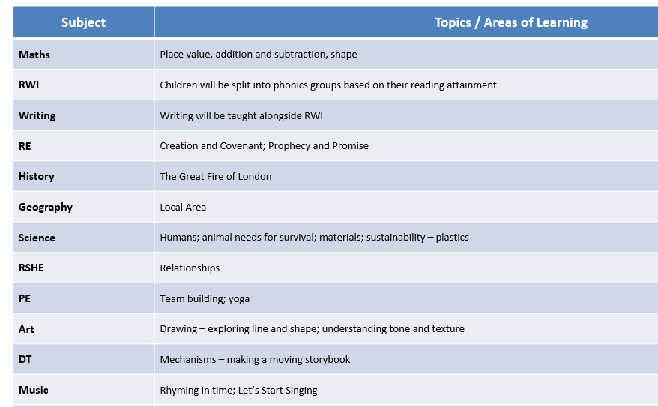
Autumn term topics

Slide 20
Any questions?
If you still have any questions about The St Teresa’s Way, please don’t hesitate to contact us via the school office or email.

